Slide 1
Code Alpha Internship
Ajayraj Pasi (943)

Slide 2
Objective
TITANIC CLASSIFICATION
Make a system which tells whether the person will be save from sinking.
What factors were most likely lead to success-socio-economic status, age, gender and more.

Slide 3
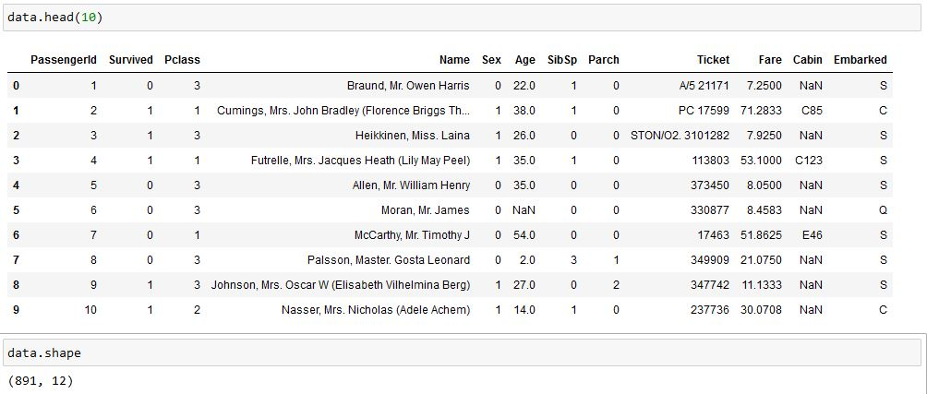
Dataset Snapshot

Slide 4
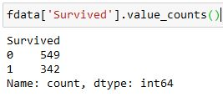
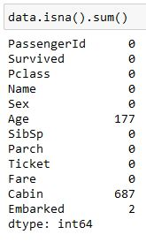
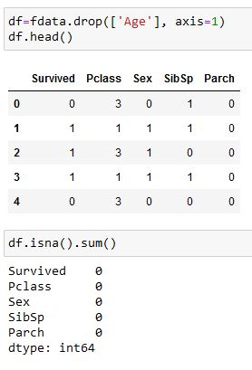
Basic Data Cleaning
Survived are less

Slide 5
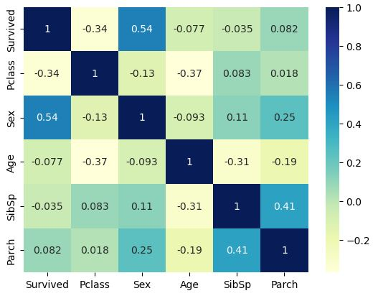
Correlation Plot
Sex
-0.34
Pclass
0.54

Slide 6
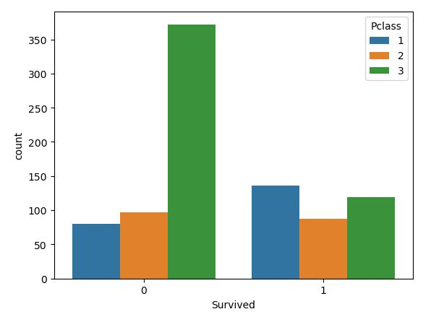
Survived based on Ticket Class (1st ,2nd ,3rd )
Survival is more in higher Ticket Class

Slide 7
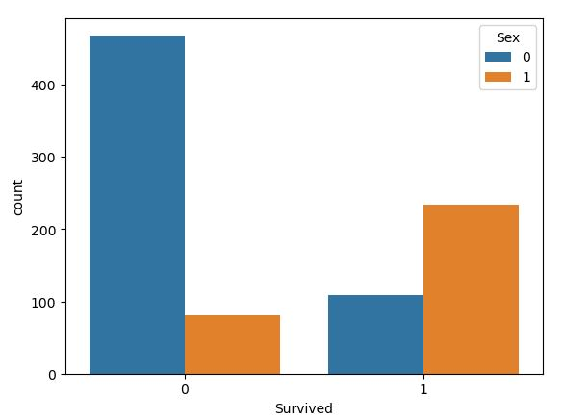
Survived based on Gender
Female survivors are more as compared to male survivor

Slide 8
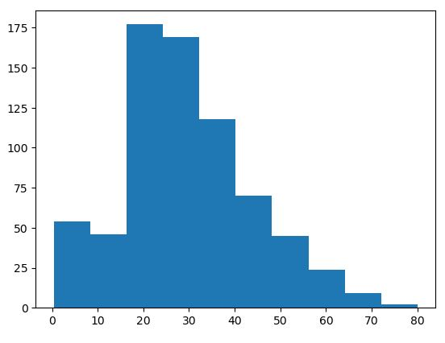
Average Age of people on board
Average age of people on board was
20 to 35

Slide 9




Regression Model
We will use Second Model

Slide 10
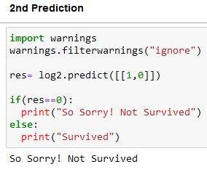
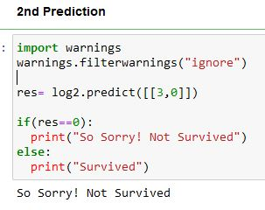
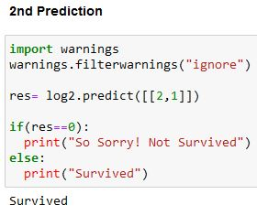
Prediction

Slide 11
Conclusion Table
 | 1st class | 2nd class | 3rd class
Female | Highest | High | Medium
Male | Medium | Low | Not Sure
Chances of Survival is high only for females Medium only for first class ticket males

Slide 12

Reference
https://www.geeksforgeeks.org/bar-plot-in-matplotlib/
https://www.kaggle.com/competitions/titanic/data
https://www.codealpha.tech/

Slide 13
Thanks!

